Slide 1
PSYC100 GENERAL PSYCHOLOGY
PERCEPTION

Slide 2
Lecture Outline
What is perception?
Gestalt Psychology
Depth perception
Perceptual consistency
Illusions
Theories of visual perception

Slide 3
What is perception?
Perception is the organisation and interpretation of incoming sensory information to form inner representations of the external world.
We don’t perceive ‘reality’ at all but only how our brain interprets it (Macknik & Martinez-Conde, 2014).
Ehrenfels (1890) claimed that many groups of stimuli acquire a pattern quality that is greater than the sum of their parts.
  E.g. Melody. If you hear the notes of a song played individually, they’re just separate sounds. But when played together in sequence, they form a recognizable melody with a unique quality
Gestalt Psychology argues that our brain organizes sensory information—like shapes, sounds, or images—into meaningful wholes.
  E.g. face

Slide 4
What is perception?
Distal stimulus – the object you are looking at
Proximal stimulus – the pattern of stimulation that hits the retina
While the distal stimulus is constant, the proximal stimulus varies.
A major issue for perception is how your perception remains constant when the proximal stimulation is so variable.

Slide 5
Gestalt principles of perceptual organization
  Figure-ground separation
  Proximity
  Closure
  Similarity
  Continuity
  Symmetry
  * 2-6 are called Laws of perception

Slide 6
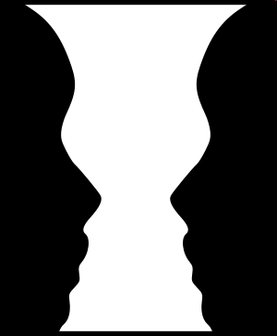
Figure-ground separation
The first perceptual task when confronted with an object (or figure) is to recognise it. To do this, we must perceive the figure as being distinct from its surroundings (or ground).

Slide 7



Slide 8
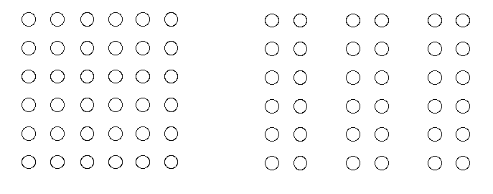
Proximity
Occurs when elements are placed close together. They tend to be perceived as a group.
The Gestalt principle of proximity suggests that you see (a) one block of dots on the left side and (b) three columns on the right side.

Slide 9


Slide 10
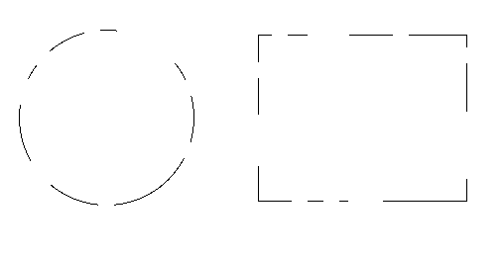
Closure
We tend to complete incomplete forms and generally fill in the gaps
Closure suggests that we will perceive a complete circle and rectangle rather than a series of segments.

Slide 11


Slide 12
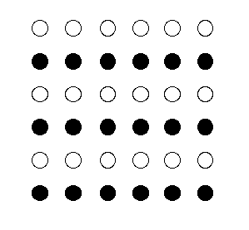
Similarity
Similar parts of a form are more likely to be perceived as belonging together than parts that are dissimilar.
When looking at this array of dots, we likely perceive alternating rows of colours. We are grouping these dots according to the principle of similarity.

Slide 13


Slide 14

Continuity
We group stimuli into forms that follow continuous lines or patterns.
Good continuation would suggest that we are more likely to perceive this as two overlapping lines, rather than four lines meeting in the center.

Slide 15


Slide 16
Symmetry
Elements that are symmetrical to each other tend to be perceived as a unified group.
Similar to the law of similarity, this rule suggests that objects that are symmetrical with each other will be more likely to be grouped together than objects not symmetrical with each other.

Slide 17
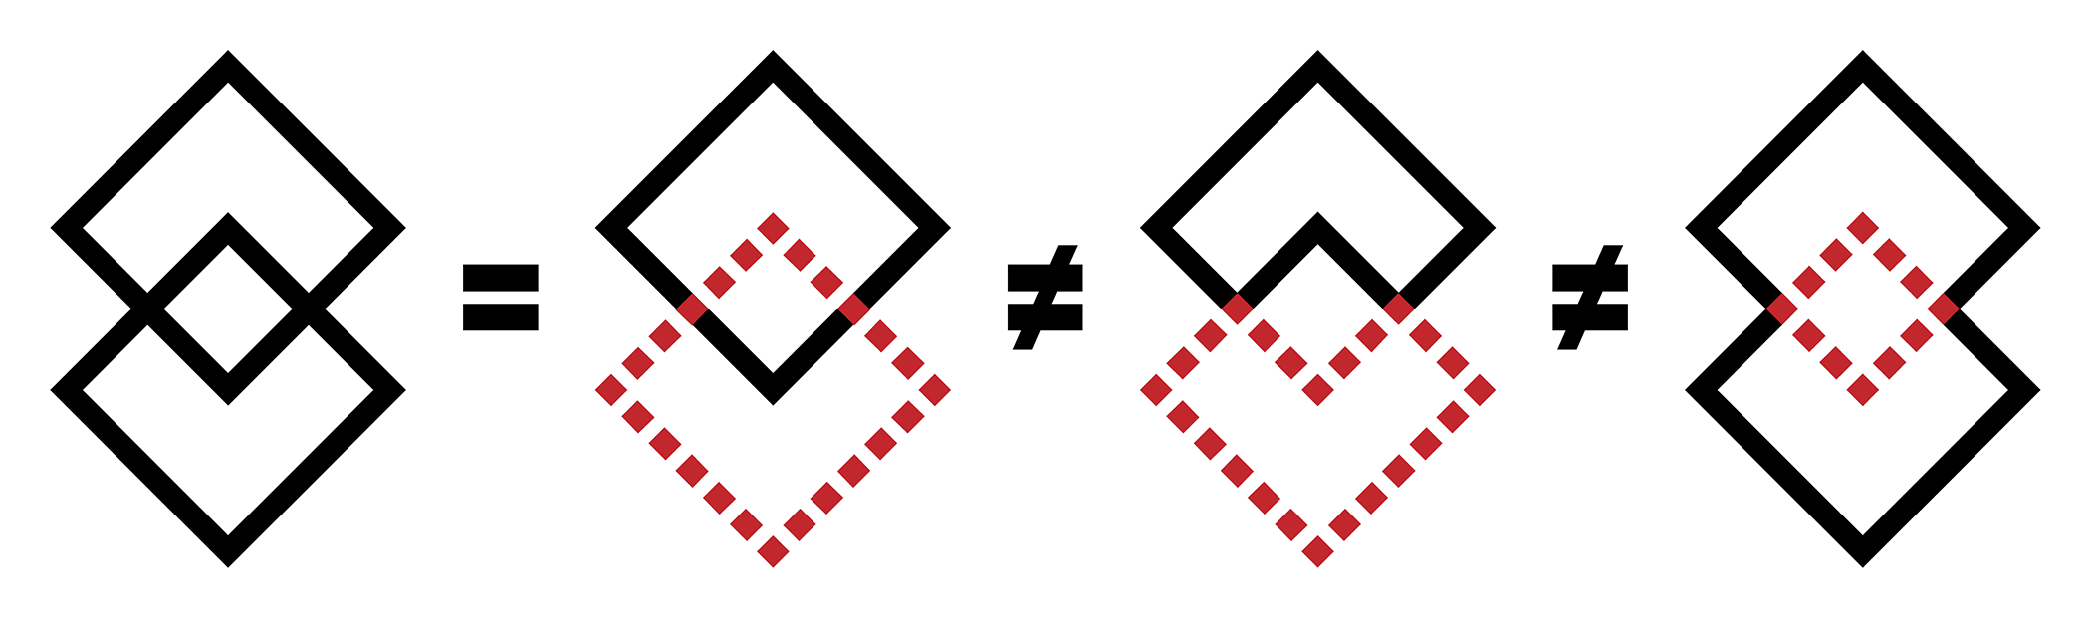
We see these shapes as two overlapping diamonds instead of as two touching corner bricks or an octahedron with a square in the middle.

Slide 18


Slide 19
Depth perception
Depth perception is the ability to see things in a 3-dimensional way and to judge distance.
We use depth cues to gather information on the images we see. These cues are monocular and binocular cues.
Binocular cues involve both eyes and rely on their working together, while monocular cues are available to each eye separately.

Slide 20


Predator vs Pray

Slide 21
Non-pictorial cues
Nonpictorial cues involve the physical functioning of the eyes and brain rather than interpreting visual patterns in a scene. They include:
Retinal Disparity (Binocular Cue): The slight difference in the images projected on each retina due to the eyes' horizontal separation. The brain uses this disparity to estimate depth, especially for objects within a few meters.
Convergence (Binocular Cue): The inward rotation of the eyes to focus on a nearby object. The degree of convergence (angle of eye movement) provides the brain with information about an object’s distance.

Slide 22
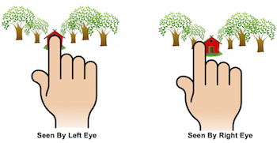
Retinal disparity

Slide 23
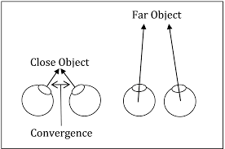
Convergence

Slide 24

Pictorial cues
These refer to features of the visual field itself (rather than to the eyes), and are all also monocular.
1. Relative Size: Objects that are farther away appear smaller than similar objects that are closer.

Slide 25

Pictorial cues
2. Interposition (Occlusion): When one object partially blocks another, the blocked object is perceived as farther away.

Slide 26

Pictorial cues
3. Linear Perspective: Parallel lines (e.g., railroad tracks) appear to converge as they recede into the distance, signaling depth.

Slide 27
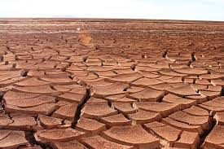
Pictorial cues
4. Texture Gradient: Textures appear denser and less detailed as they get farther away.

Slide 28
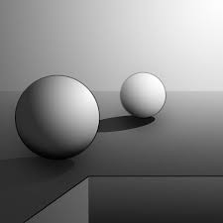
Pictorial cues
5. Light and Shadow: The way light falls on objects creates shadows that indicate their shape and position in 3D space.

Slide 29

Pictorial cues
6. Aerial Perspective: Distant objects appear hazier or less vivid due to atmospheric scattering of light, suggesting greater distance.

Slide 30

Pictorial cues
7. Relative Height: Objects higher in the visual field (closer to the horizon) are perceived as farther away, especially in landscapes.

Slide 31
Perceptual consistency
The ability to perceive an object as unchanging, despite changes in the sensory information that reaches our eyes, is called perceptual constancy.
  Size constancy
  Shape constancy
  Brightness constancy
  Colour constancy
  Location constancy

Slide 32

Size constancy
The brain perceives an object’s size as constant, even though its retinal image changes with distance. For example, a person appears the same size whether they are 5 or 50 feet away, despite the retinal image being smaller at a distance (Ramachandran and Rogers-Ramachandran, 2004).

Slide 33
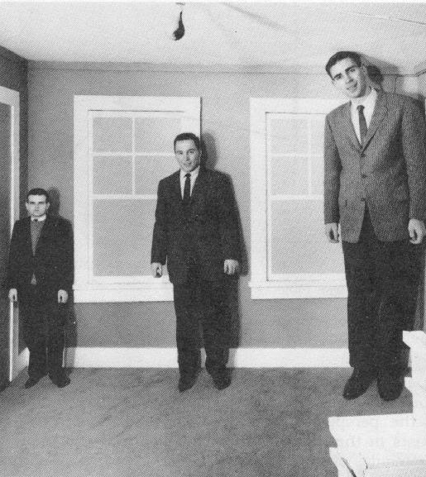
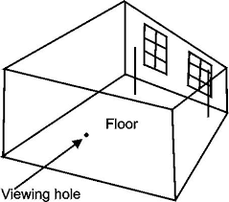
Ames Room (Ames, 1946)
In the Ames room, the walls, floor, and ceiling are trapezoidal, not rectangular. Your brain interprets both corners as being at the same distance, even though one is farther away.

Slide 34
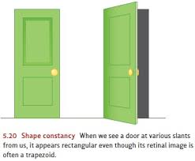
Shape constancy
An object’s shape is perceived as consistent, even when viewed from different angles, which alters its retinal projection. For example, a door appears rectangular whether viewed head-on or at an angle, where it projects a trapezoid on the retina.

Slide 35
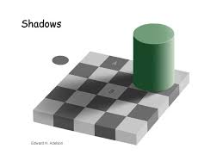
Brightness constancy
Objects are perceived as having consistent brightness, even when illumination changes. For example, a white shirt appears equally white in bright sunlight or dim shade, despite differences in light intensity reaching the retina.

Slide 36
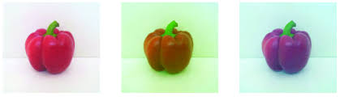
Colour constancy
The brain perceives an object’s colour as stable under different lighting conditions. For example, a red apple looks red in sunlight or under fluorescent light, even though the wavelengths reflected change.

Slide 37
Location constancy
Moving our heads around produces a constantly changing pattern of retinal images, yet we don’t perceive the world as spinning around. This is because kinaesthetic

Slide 38
Illusions
These offer examples of how perception can be wrong and how what we see is not the truthful reflection of what's out there
Perception is based not only on the stimulus but also knowledge and experience
The Ponzo illusion
The Horizontal-Vertical illusion
The Muller-Lyer illusion
The Poggendorf illusion
Titchener’s circles

Slide 39
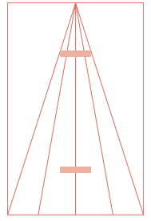
The Ponzo Illusion
The horizontal bar at the top is seen as being longer than the horizontal line at the bottom, even though they’re both the same length.

Slide 40
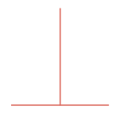
The Horizontal-Vertical Illusion
The vertical line appears longer than the horizontal line – even though they’re of equal length.

Slide 41
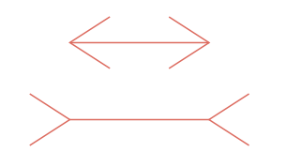
The Muller-Lyer Illusion
The line with the outgoing fins appears to be longer than the line with the ingoing fins, but in fact they’re the same length.

Slide 42

The Poggendorf Illusion
Seems like the segments of the diagonal line are offset, even though they’re not.

Slide 43
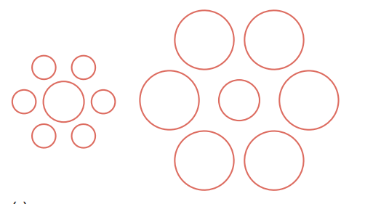
Titchener’s circles
The central circle in the left-hand group is seen as being larger than the central circle of the right-hand group, but they’re both the same size.

Slide 44
Theories of Visual Perception
Gestalt Theory (as discussed - "the whole is greater than the sum of its parts.“
2. Constructivist Theory (Gregory, 1966) - perception is an active, constructive process. The brain uses sensory input, prior knowledge, and expectations to build an interpretation of the visual world. Perception is driven by higher-level cognitive processes, such as memory, experience, and context. For instance, we recognize a blurry image as a face because we’ve seen faces before.
e.g. When reading messy handwriting, your brain uses context and prior knowledge of words to decipher the text, even if some letters are unclear.

Slide 45
Theories of Visual Perception
3. Ecological Theory (Gibson, 1966) - perception is direct and does not require complex cognitive processing. The environment provides all the information needed for perception through "affordances" (cues about how objects can be used). Gibson’s theory emphasizes the interaction between organisms and their environment, focusing on real-world, ecological contexts rather than lab-based stimuli.
e.g. When walking through a forest, you perceive the ground’s texture and slopes directly, allowing you to navigate without consciously analyzing every step.

Slide 46
Aspect | Gibson's Direct (Ecological) Theory | Gregory's Constructivist (Indirect) Theory
Key assumptions | Perception is direct and bottom-up; we "pick up" invariant information from the environment without needing inferences. | Perception is indirect and top-down; the brain constructs perceptions by testing hypothesis based on sensory data and prior knowledge.
Role of environment | Central; the optic array provides rich, unambiguous information (e.g., affordances) that specifies what actions are possible. | Provides incomplete or ambiguous sensory input, which must be supplemented by cognitive processes.
Role of cognition | Minimal; perception happens as a result of direct resonance with the environment. | Essential; involves active interpretation using past experiences, expectations, and inferences.
Explanation of illusions | Occur due to insufficient or artificial environmental information (e.g., in lab settings), not cognitive errors. | Result from misapplied hypotheses or perceptual errors based on prior knowledge (e.g., size illusions from depth cues).

Slide 47
Theories of Visual Perception
While Gregory’s constructivist (‘top-down’) and Gibson’s direct (‘bottom-up’) approaches may appear to contradict each other, it’s possible to see them as complementary. According to Harris (1998): “Perception is not just a single task but …contributes in many different ways to everyday life … Some of these … are obviously more difficult than others and it seems likely that some can be accomplished directly, as Gibson maintained, whilst others may require sophisticated internal knowledge and are thus better described by the indirect approach.”

Slide 48
Lecture summary
What is perception?
Laws of perception
Depth perception: pictorial and non-pictorial cues
Principles of constancy
Illusions
Ecological and Constructivist theories of visual perception

